Slide 1
Estimating Electricity Pricing using Machine Learning
Cormac Duffy
B00806474

Slide 2
Presentation Overview
Sections to include in the Presentation :
The Project (3-4)
Your Solution (5-6)
Evaluation (7-9)
Reflection(10-11)

Slide 3
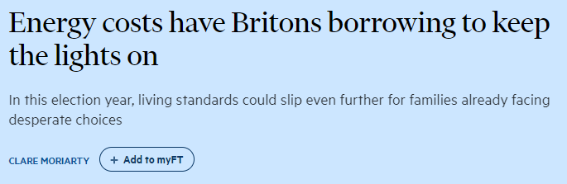
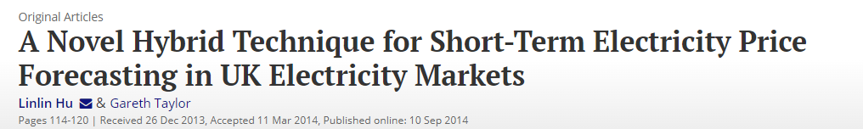
The Project
The recent economic landscape has been marked by a cost-of-living crisis
This led to a jump in pricing on products across many industries including electricity
Electricity is a large portion of household bills.
Use Machine Learning algorithms to predict and forecast future electricity pricing on a yearly average basis

Slide 4
The Project
Data that will be used:
The Dataset used comes from a reliable source, the UK Government. It is historical electricity data ranging from 1920-2022, the dataset includes a wide range of data such as:
Timeframe – 1920 – 2022
Electricity Pricing History
Fuel Input
Supply and Availability
Consumption
Generation
Supplied Electricity
Capacity
Synthetic Data:
Created for individual fuel inputs pricing due to incomplete yearly data, using available share contribution data.
Notes:
Data Details: Covers average net selling value to all consumer types (general, industrial, commercial).

Slide 5
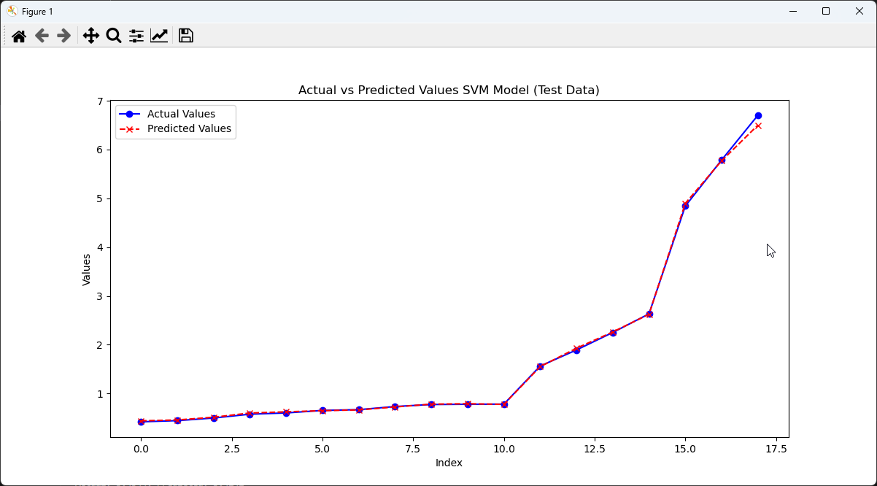
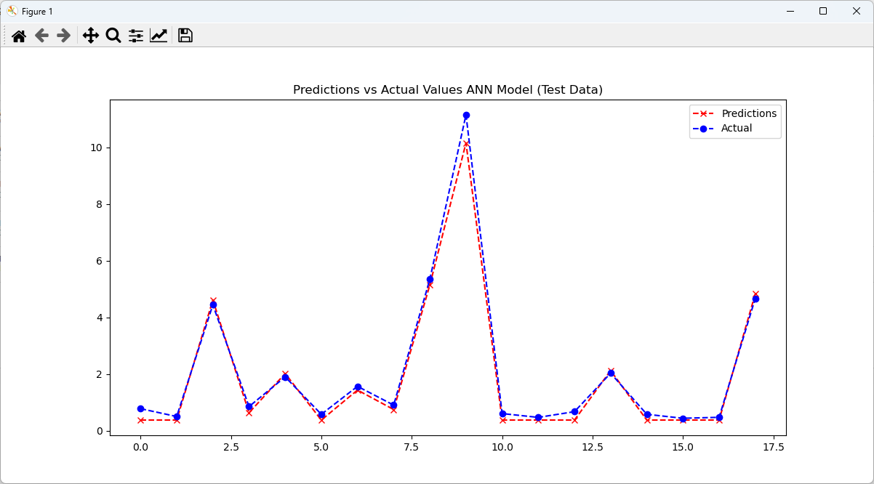
My Solution
Yearly Average Price Prediction Model:
Implemented two different regression Machine Learning Models, Artificial Neural Networks and Support Vector Machine for our forecasting using appropriate libraries like TensorFlow and SKLearn

Slide 6
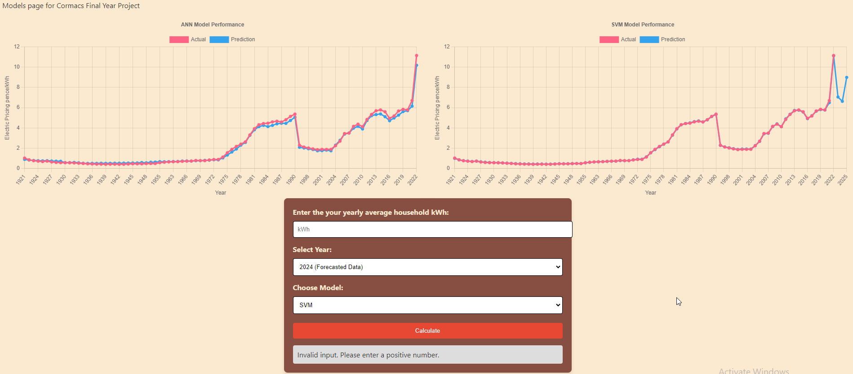
My Solution
Long Term Budgeting Tool
Created a website with our predictive analysis and forecasting results that includes a calculator that takes the forecasts from the models and allows you to input your yearly kWh usage in household to get an estimate of how much the next year will cost.

Slide 7
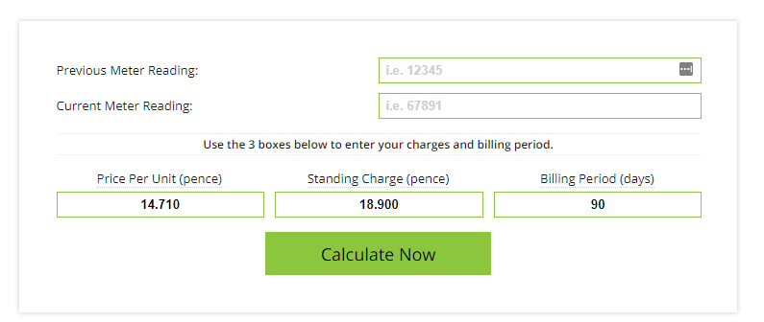
Evaluation
Goals Met
Developed two different Machine Learning Models for prediction and forecasting
Produced visual performance outputs for Model Evaluation
Created website that displays predictive and forecast data
Created calculator feature that allows users to use that forecasted data.
Created and integrated database
Quality of Project
Availability of all required data
Met requirements initially set out
Innovation
Long term forecasting with ML, similar work focused on smaller time frames.
Allows household users to access predictive modelling data for electricity price forecasting.
Notes:
Completion of Project
Major Features: Completed all major features except one.
SVM Forecasting: Successfully implemented for fuel imports and predictions.
ANN Models: Prediction completed; forecasting pending.
Website Functionality: Essential pages and a calculator for SVM-based electricity price forecasting are fully functional.
Data Quality and Sources
Importance of Data: Emphasizes that model performance heavily depends on data quality.
Data Source: Utilizes electricity pricing data from UK Government, spanning from 1920 to 2022.
Data Details: Covers average net selling value to all consumer types (general, industrial, commercial).
Synthetic Data: Created for individual fuel imports pricing due to incomplete yearly data, using available share contribution data.

Slide 8
Evaluation
Relevance:
The project is relevant to the target audience (electricity consumers)
The project is unique
Long Term Electricity Forecasting
Electricity Pricing Calculator using ML forecasting
Enhanced Decision Making
ML Models extract valuable insights from data, allowing users to make informed decisions
ML Models use patterns to base their predictions, removing human bias
Skills and Expertise
Research and review
Data Science
Understanding and Reading Code

Slide 9
Evaluation
Time Management
Main objectives were completed within the 24-week period
Setbacks in project plan – Problems with Data and ANN Forecasting Model
Time Budget
Completed within the allotted time
Made use of resources available
Weekly Meetings with Supervisor
Peer Review with other Students
Interim Feedback

Slide 10
Reflection
Lessons Learned
Importance of the quality of data and data limitations
Model Complexity vs Performance
Hyperparameter Tuning
Adjustments for Future
Incorporate more features in the model
Hyperparameter Optimisation Techniques
Notes:
Lessons Learned
Importance of Data – Understanding the completeness, usefulness and quality of the data. Garbage in Garbage Out.
Model Complexity vs Performance – More Complex does not mean better, can lead to overfitting
Hyperparameter Tuning – It is tedious and time consuming but important for achieving optimal model performance
Future Situations
More features – Include additional relevant variables like macroeconomic indicators, seasonal factors or geopolitical events
Hyperparameter Optimisation Techniques – Use more advanced tuning techniques for ANNs like Bayesian optimisation with Keras Tuner

Slide 11
Reflection
Overcoming Challenges
Challenges included lack of yearly average data for fuel sources
Overcame this challenge by creating synthetic data based on the share of these fuels' sources contributing to electricity generation
Success and Unexpected Outcomes
Successful creation and evaluation of ML Models for Electricity Price Forecasting
Unexpected outcomes include failing to get the ANN Forecasting Model to produce useable results
Self-Evaluation
Improved skills in data pre-processing, modelling, model evaluation and python
Identified areas for improvement, particularly in hyperparameter tuning for ANN and data.
Future Strategies
Implement online learning, modifying the model to update itself as new data comes in
Explore more advanced modelling and scaling techniques.

Slide 12
Thanks for Listening
Summarize
Notes:
The project demonstrates the potential of machine learning in enhancing decision-making for household electricity expenses, providing a tool that aligns with user needs in the face of economic changes, by integrating machine learning models into a practical application. Moving forward, the project could potentially transform how consumers interact with and manage their energy usage in an increasingly dynamic economic landscape. This work shows the transformative power of combining data science with user-centric applications to address real-world challenge

